Slide 1
LP-06-Arrays
QPS
Arrays-QPS
Kartik Mathur

Slide 2
Question!
Find the maximum of all the elements on the left side in an array using:
1st way : nested loop, store answer in new array
2nd way : Single loop, store answer in new array
[1, 3, 5, 2, 3, 6, 8, 2, 11, 5]
Output:
[-1, 1, 3, 5, 5, 5, 6, 8, 8, 11]
Notes:
Discuss two pointer approach and using O(N) space

Slide 3
Question!
Find the maximum of all the elements on the right side in an array using:
- Single loop, store answer in new array
[1, 3, 5, 2, 3, 6, 8, 2, 11, 5]
Output:
[11, 11, 11, 11, 11, 11, 11, 11, 5, -1]
Notes:
Discuss two pointer approach and using O(N) space

Slide 4
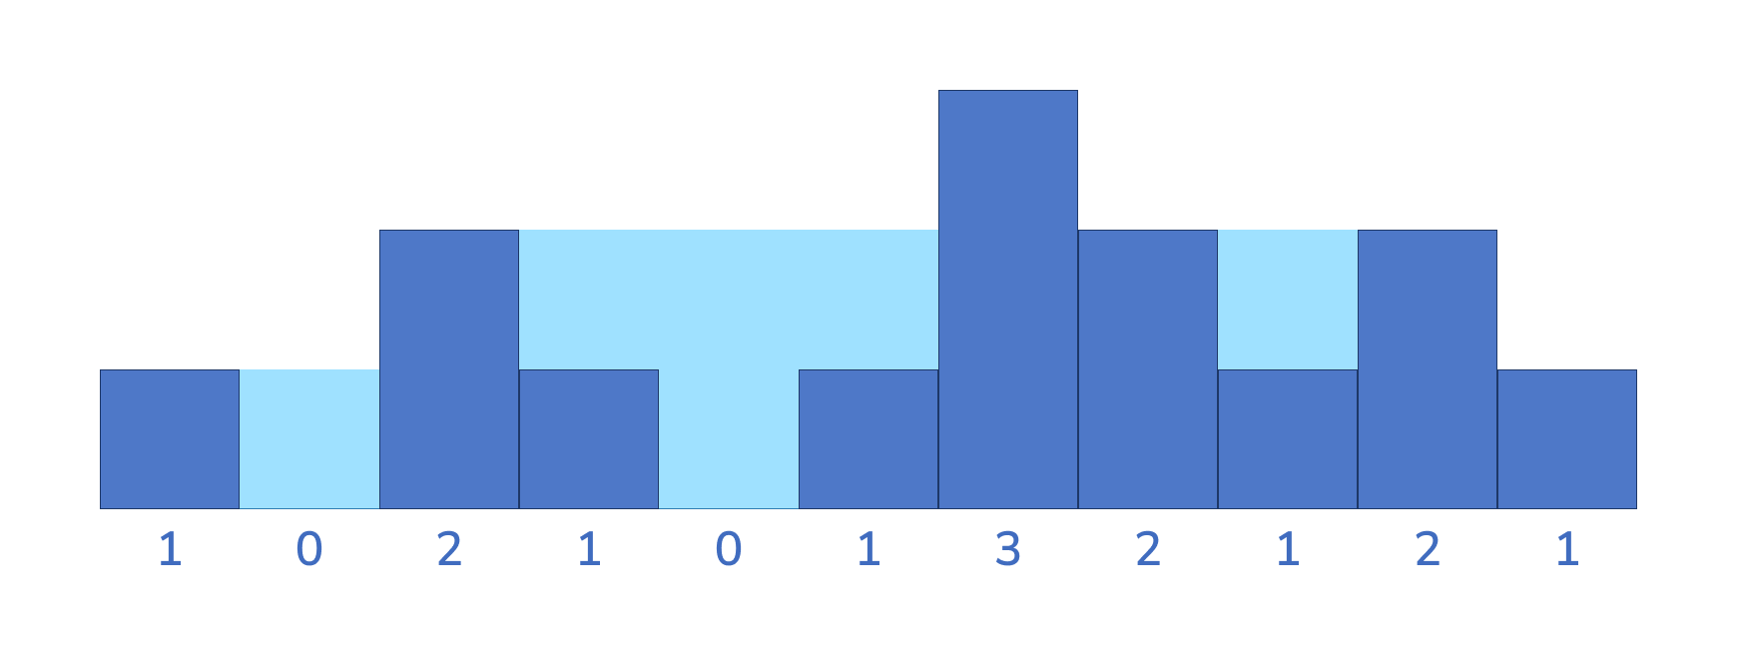
Rain-water trapping?
Using previous concepts let’s find the solution to this:
https://codeskiller.codingblocks.com/problems/327
Notes:
Discuss two pointer approach and using O(N) space

Slide 5
Graphs
Thankyou
Kartik Mathur

